Slide 1
Analysing REF
Industrial team project (ITP) 2017
Team Members:
Eleanor Woodhead
Weijiang Lin (Gloria)
George Chrysostomou
Rawaida Kamarudin
Jagoda Karpowicz

Slide 2
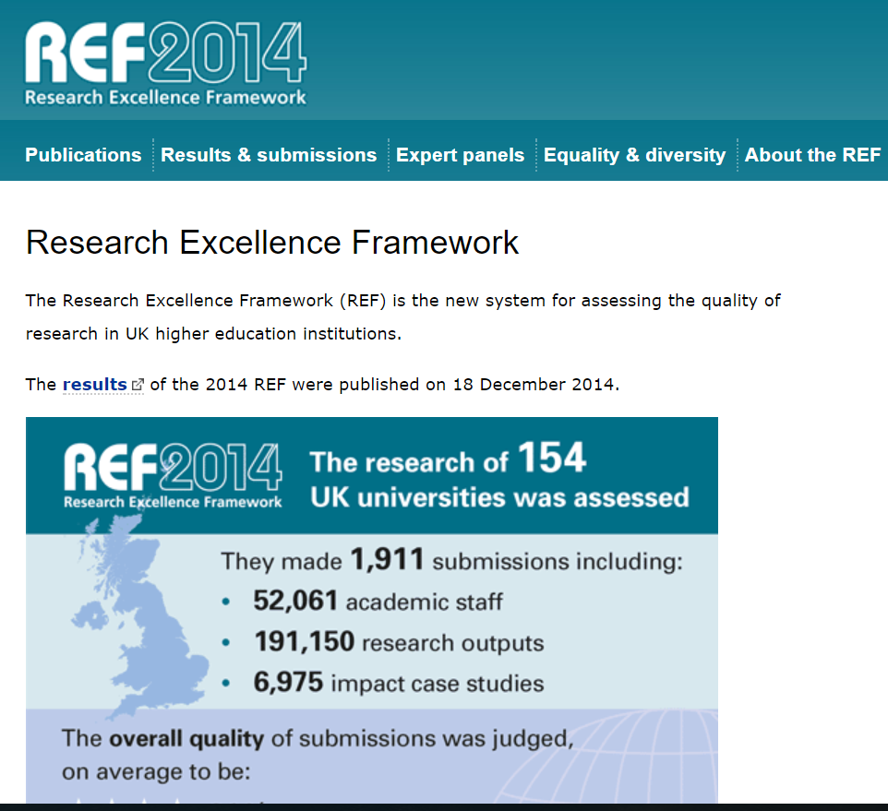
WHAT IS THE RESEARCH EXCELLENCE FRAMEWORK (REF)?
Formal system for assessing quality of research in UK
Primary purpose – determine proportion of public funding allocated to individual universities for research
Replace Research Assessment Exercises (RAE) (last conducted in 2008)
Conducted every 5 to 6 years
Notes:
Background

Slide 3
WHAT IS OUR GOAL for this PROJECT?
PROJECT AIM
Discover features from data that affect the outcome of REF
WHY ?
Understand what factors are most important for getting a good REF rating
PROJECT VISION
Create a predictive model for REF results
Notes:
Main objectives

Slide 4
What is our approach?
Validation and Interpretation of Results
Validation and Interpretation of Results
Testing Hypotheses
Validation and Interpretation of Results
Testing Hypotheses
Defining Hypotheses
Testing Hypotheses
Defining Hypotheses
Preparing the Data
Defining Hypotheses
Preparing the Data
Understanding the task
Preparing the Data
Understanding the task
Perform simple statistics on data
Extracting & analysing data using R, WGet & Python
Build questions that have potential correlation
Examine & combine the data
(please add on details for this?)
Have a list of features with good / not-so-good correlations in-between features not always with final scores
Notes:
Envisaged tasks / questions to be explored
Methods to be used, possibly including details on software to be used

Slide 5
WHAT IS OUR PROJECT TIMELINE?
Each team member will be accountable for
2 units of assessments (fields of interest) in REF
Pls add on details here
Notes:
A schedule of the work (time and allocation to team members)
The data extraction and cleaning stage shall last 2 weeks and will involve using programs to first of all download key points of data from the RAE and REF websites, then processing this data in python/excel, need to find out in order to use it in statistical packages.
The Detailed Data Analysis and Model development stage lasts 4 weeks and is the stage where we take that cleaned data and input it into a statistical package to identify the factors that might influence the scoring of the REF, as well as how strongly they effect the scoring. This will also be the stage where we write up our report, and attempt to construct the model mentioned earlier.

Slide 6
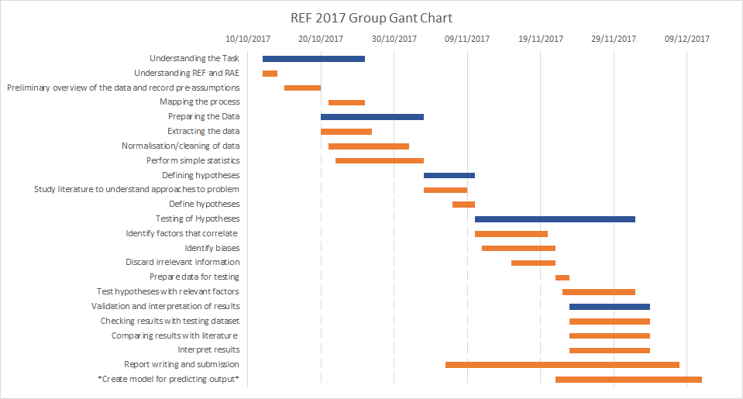

Slide 7
WHAT HAVE WE DONE THUS FAR?
STUFF
Notes:
Background

